Slide 1

TUTORIA Creating a Better World, One Student at a Time
TEAM NAME:BROCODE

Slide 2

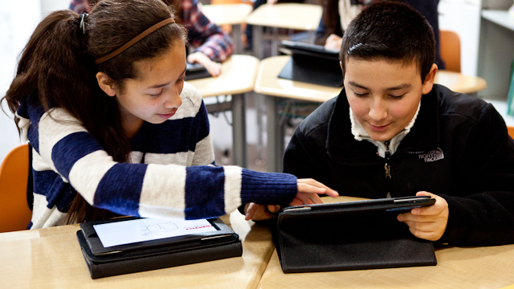
THE PROBLEM WE ARE TRYING TO SOLVE…
There are many students in need of a person they can converse with in an informal and easy-going manner, in order to achieve a better grasp of concepts. They may find tuition classes to be too cramped and private tutors hard to find.
On the other hand there are students more than willing to explain lessons and concepts in order to gain some pocket money
These two groups have trouble finding each other and organising their schedules accordingly.

Slide 3

THE SOLUTION:
Tutoria
We have made an efficient and COST EFFECTIVE setup (website) which BRIDGES THE GAP BETWEEN THESE TWO GROUPS

Slide 4

TUTORIA- an Introduction
Tutoria aims to provide an efficient and easy-to-use platform for students willing to take classes for finding a wider customer base
Tutors can provide courses to which an interested student can subscribe to
It helps students requiring assistance to find tutors based on the subject and price
Sets up a method for the student and tutor to interact with each other in order to schedule a session based on their interests and requirements

Slide 5

WHAT THE WEBSITE DOES – STUDENT SIDE
Here the user (that is the student looking for a tutor) is given a wide choice of tutors based on their needs (using filter searches)
The student can find necessary information about each tutor and choose the most suitable one
They can discuss specifics of the course, and arrange a class with the tutor, before making a payment

Slide 6
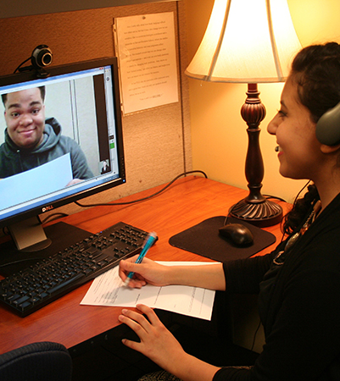
WHAT THE WEBSITE DOES(TUTOR SIDE)
The user is allowed to become a tutor after providing necessary details to ensure quality education
Once the user is registered as a tutor he/she can include their specializations into their profile which shows the details they want potential customers to see
They can discuss with the student about each other’s requirements, and if they come to an agreement, they can accept the students offer and arrange class

Slide 7
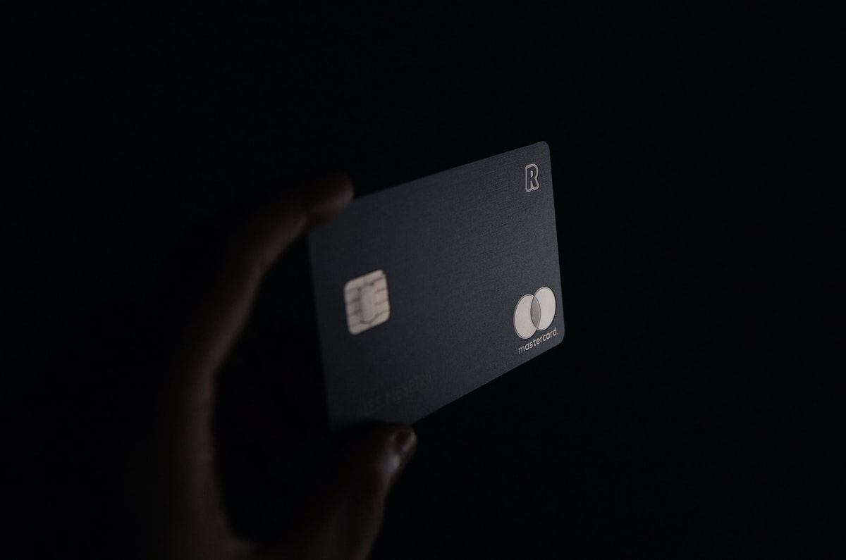
Payment process
When a student decides to purchase a course, they have to pay the course price, however it will not be sent immediately to the tutor, it will be under a scrutiny period
When the session is over the student will be asked whether they are satisfied; if the session isn't up to expectations the tutor must review the session with the student

Slide 8
Payment process
If the student is satisfied, the money will be transferred to the tutors account through the website
A small percentage of the fee will be deducted as service charges

Slide 9

Review System
The tutor and student will be able to write reviews about each other after having at least one class together.
Since the default search is by highest rating, it would provide proper incentive for tutors to perform their best
Student rating can be viewed by tutors before accepting their class request

Slide 10
Site Description

Slide 11
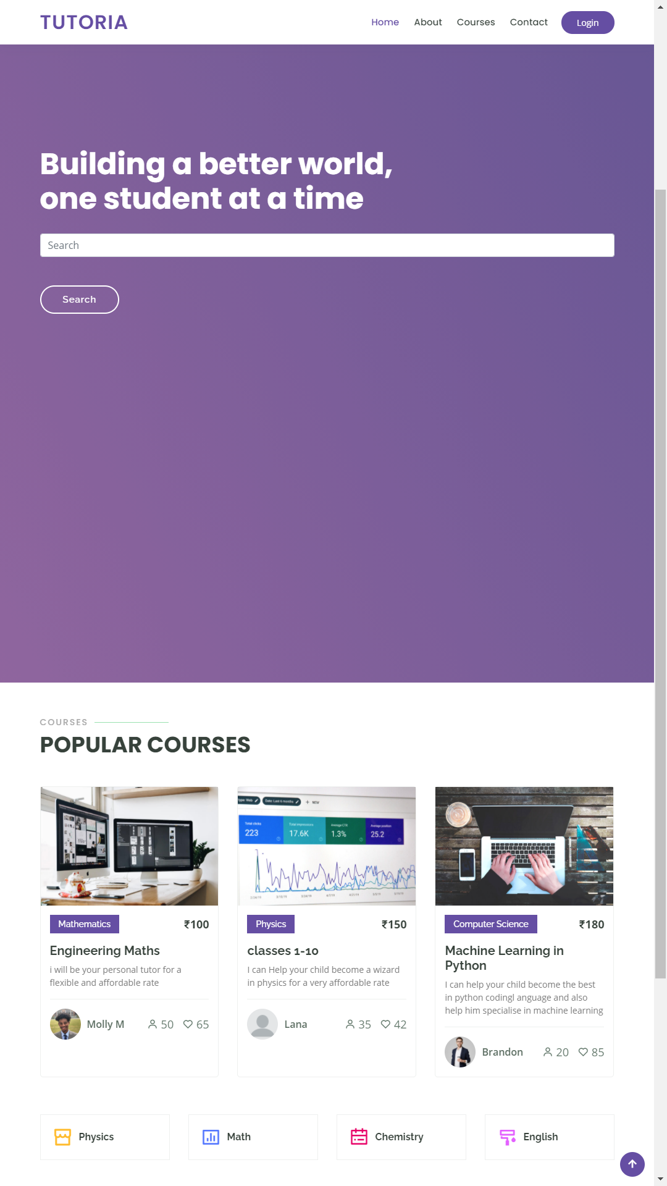
HOMEPAGE
Site Description
Provides option to search for courses and
lists popular courses to welcome new and
existing users

Slide 12
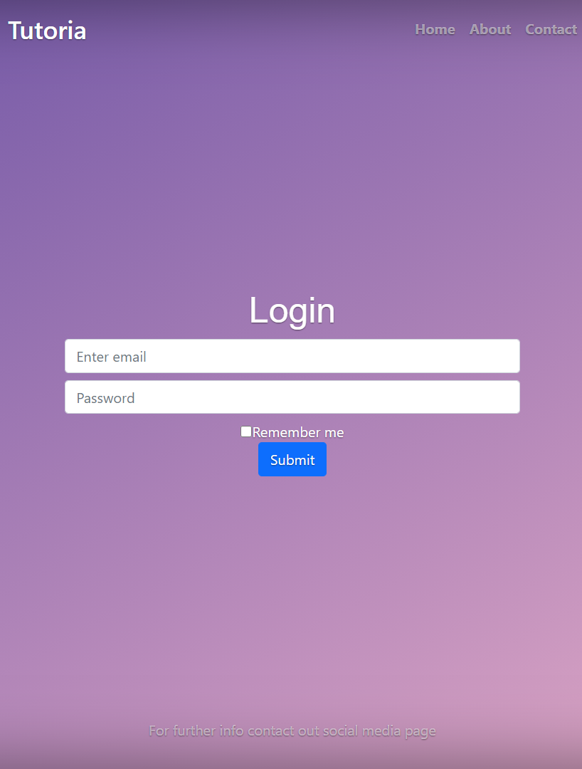
Site Description
Log in
Opens when user clicks Log in
User is required to be signed in to use
Tutoria Facilities

Slide 13
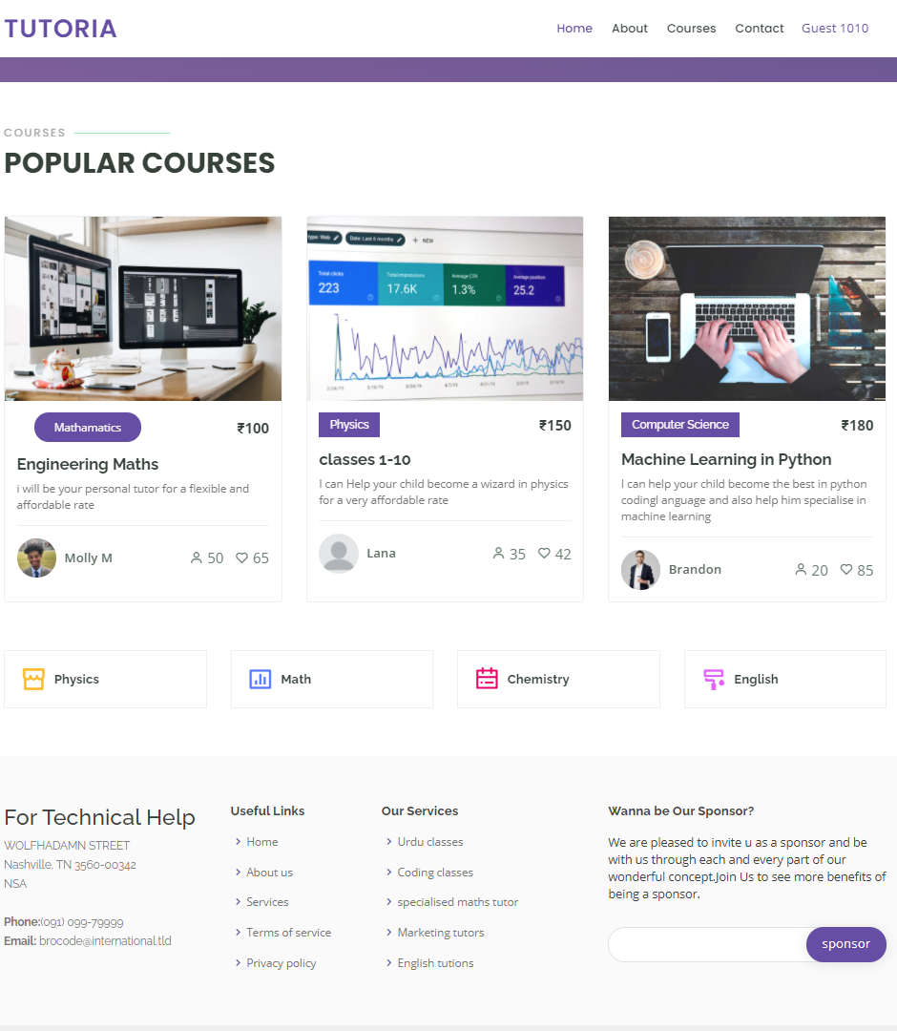
Site Description
Courses
Shows a curated list of courses
Based on the user’s previous
activities

Slide 14
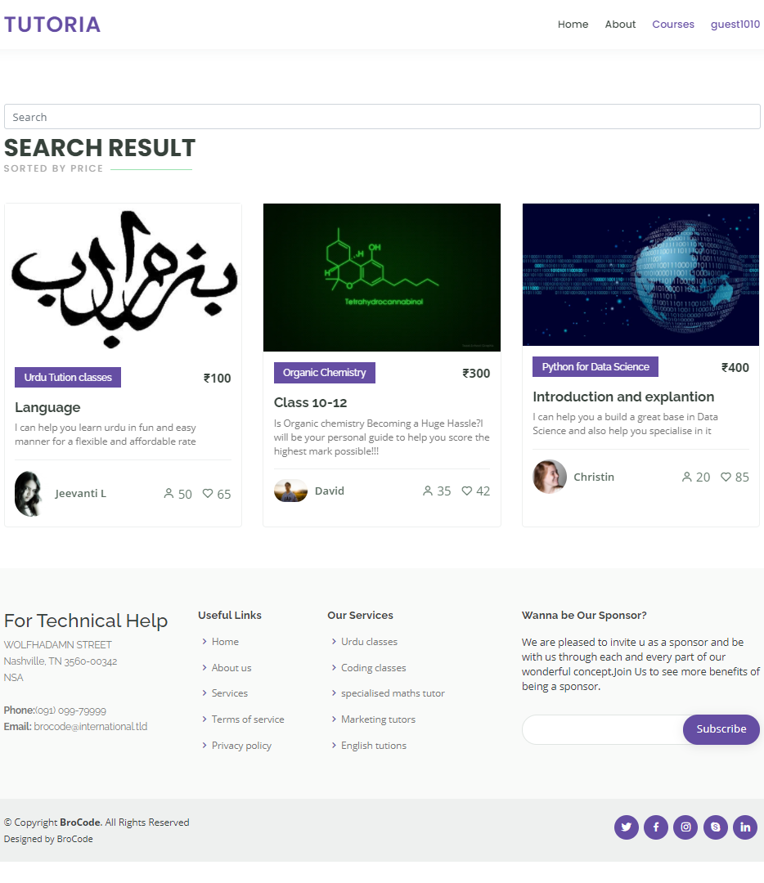
Site Description
Search
Shows a list of courses based on
what the user searches

Slide 15
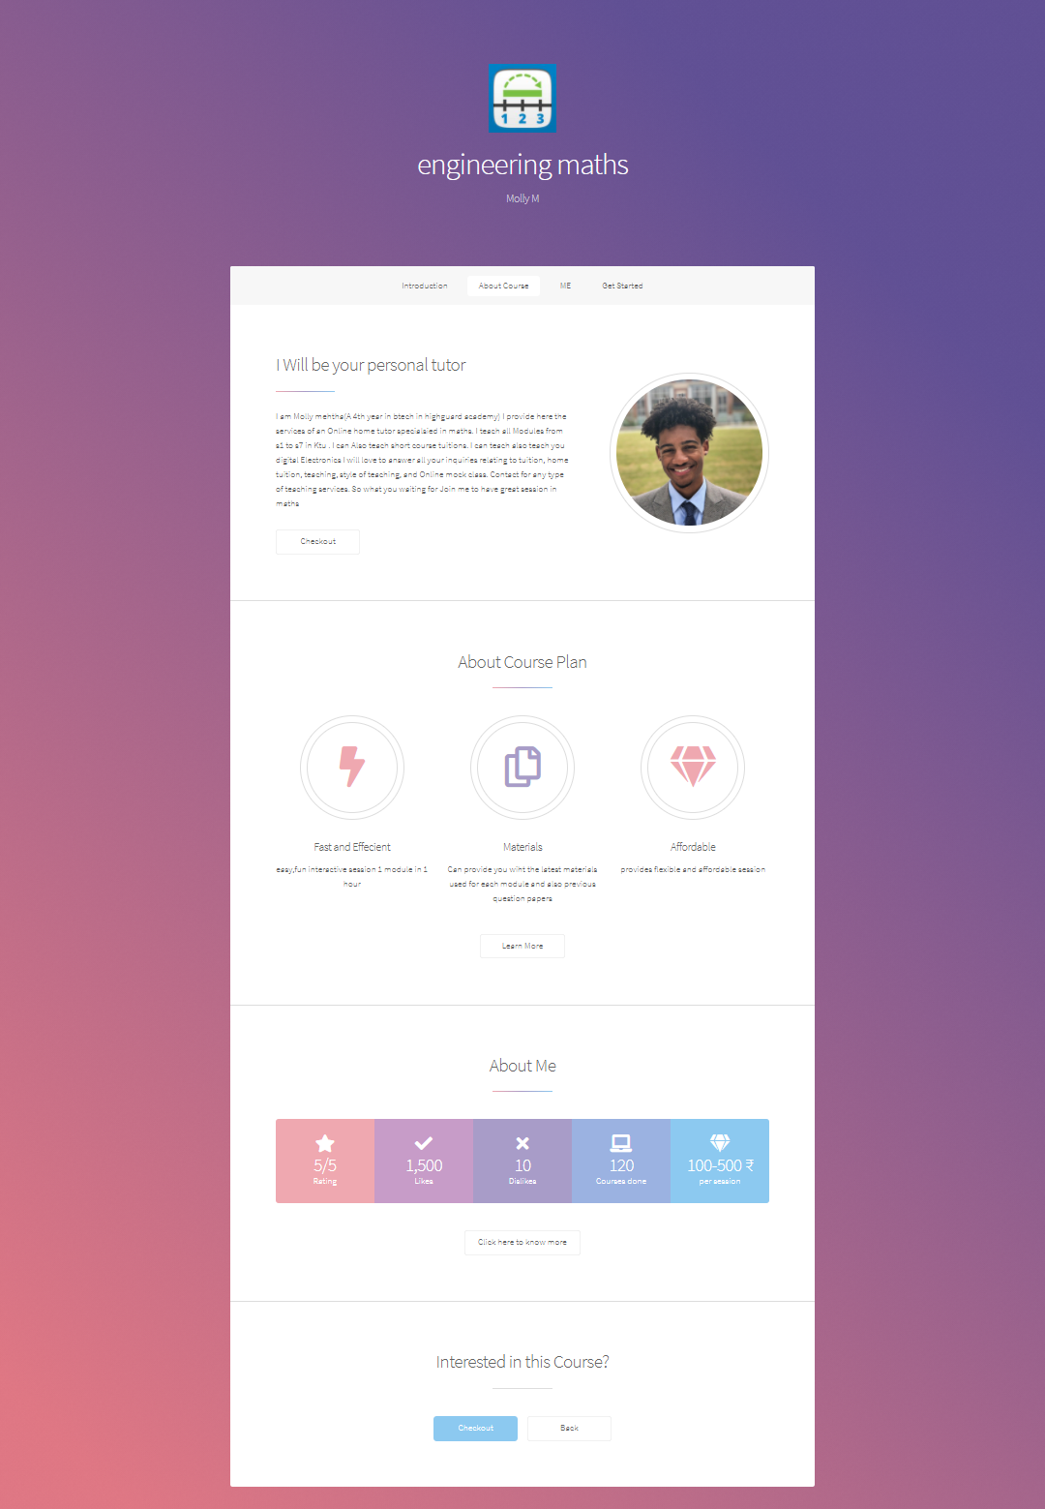
Site Description
Course Page
Tutors give details about their course here,
topics to be covered, how classes will be
conducted, price tiers etc.
The student can purchase the course by
Clicking the checkout button

Slide 16
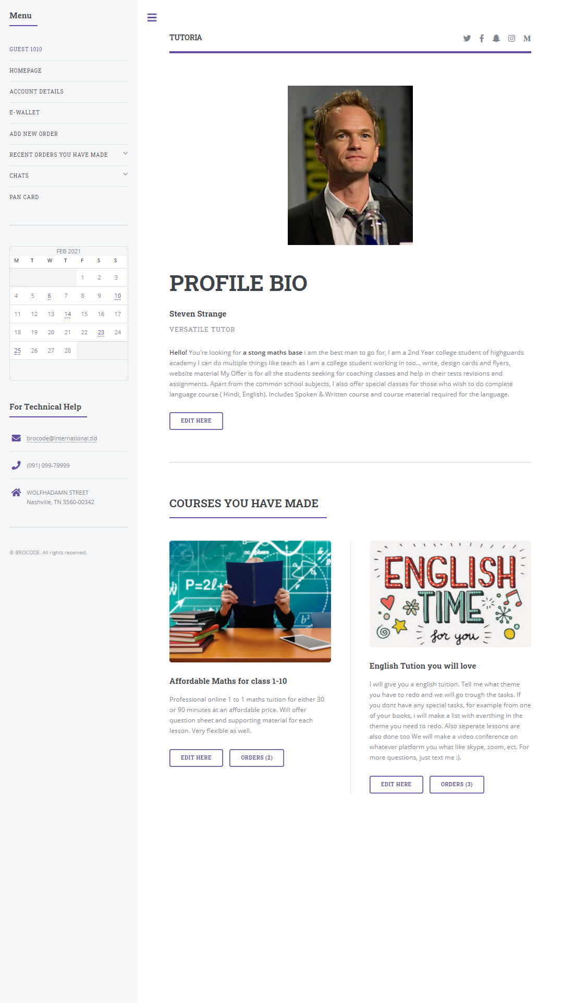
Site Description
User Account Settings
Change account details, bio, payment details
View courses you’ve signed up to as a student
View and edit courses you’ve made as a tutor

Slide 17

Future Expansions
Video Call Hosting
Instead of the site being only for scheduling classes and transactions, it would also integrate class hosting facilities
This feature would help in reducing scams and improve the general experience

Slide 18

Future Expansions
Community Forums
A free platform for general discussion of topics and doubts
This would increase the amount of people visiting the site, thus providing more potential customers

Slide 19
Thank
You
Team:
Brocode

